Slide 1
Topic 1: Introduction to Software Engineering
Software Engineering
Faculty of Computing
Universiti Teknologi Malaysia

Slide 2
Outline
What is software engineering?
Software engineering as a layered technology
Software failure and inherent difficulties in software engineering
Types of Software
Software engineering profession and ethics

Slide 3
Learning Outcome
At the end of this topic, you should be able:
Define software engineering and describe its role within the broader field of technology.
Explain software engineering as a layered technology, understanding the importance of quality focus, process, methods, and tools in SE.
Students will also analyze examples of software failure, recognizing the characteristics that contribute to failure and the inherent difficulties in software engineering, such as complexity and uncertainty.
Categorize the different types of software and discuss their various purposes and characteristics.
Understand the responsibilities and ethical considerations within the software engineering profession, including adherence to ethical standards and codes of conduct.

Slide 4
What is software engineering?

Slide 5
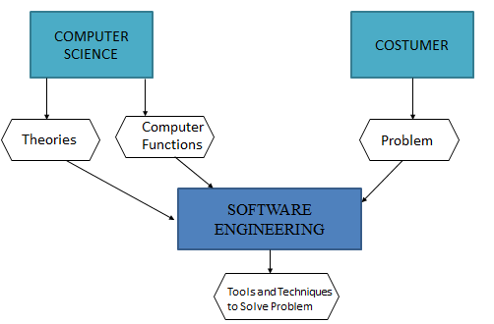
Computer Science vs.
Software Engineering
Computer science
- The study of computation & information processing, both in hardware and software
- The discipline concerned with developing large applications
Software engineering
- Covers not only the technical aspects of building software systems, but also management issues, such as directing programming teams, scheduling, and budgeting
Source : Agarwal, U. (2012). Software Engineering, Kataria and Sons.

Slide 6
Software Engineering vs.
Software Programming
Software Programming | Software Engineering
Single developer | Teams of developers with multiple roles
“Toy” applications | Complex systems
Short lifespan | Indefinite lifespan
One-of-a-kind systems | System families
Built from scratch | May be reused to reduce costs
Minimal maintenance | Maintenance accounts for over 60% of overall development costs

Slide 7
Software Engineering Definition
Software engineering is an engineering discipline that is concerned with all aspects of software production.
“The application of a systematic, disciplines, quantifiable approach to the development, operation, and maintenance of software; that is the application of engineering to software.” (IEEE, 1993)

Slide 8
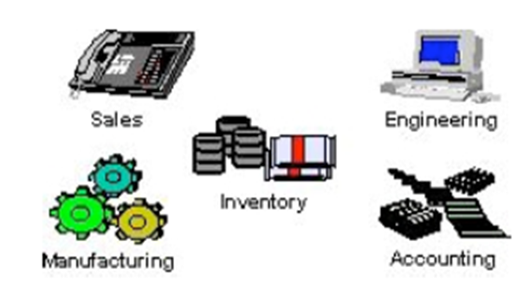
The Importance of Software Engineering
Software engineering is important because software is needed in almost every industry, business and transactions
If an application fails; a fast, efficient, and effective fix needs to happen as soon as possible

Slide 9
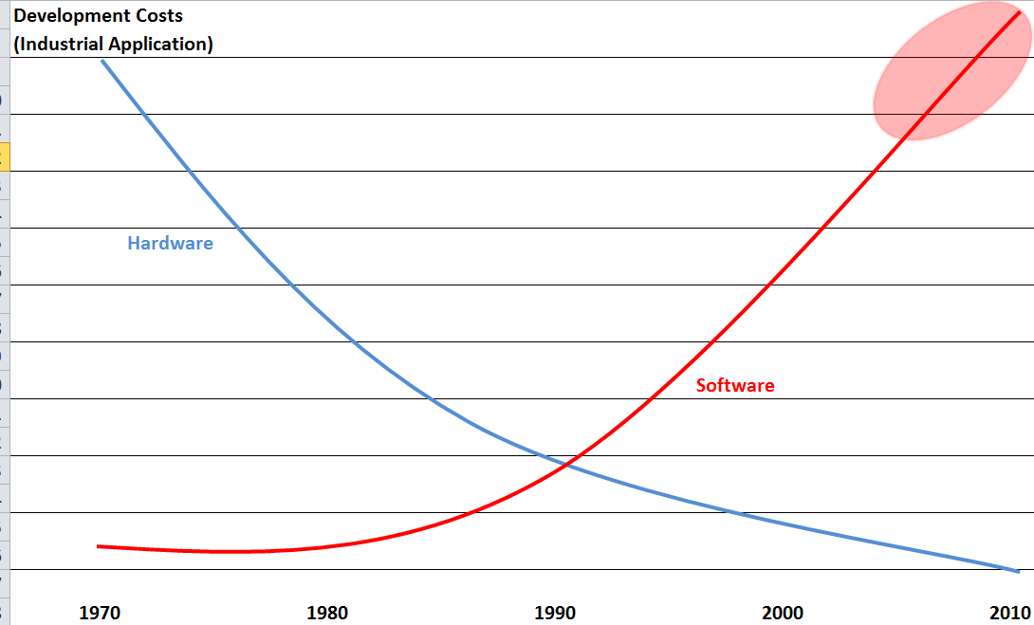
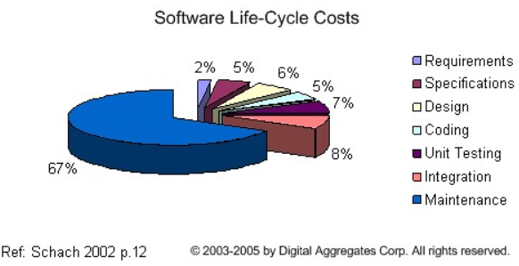
Software Engineering Costs
Software costs are often greater than that of hardware
Software costs more to maintain than it does to develop
For systems with a long life, maintenance costs may be several times higher than development costs
Therefore software engineering is concerned with cost-effective software development
Image source: http://cerescontrols.com/tutorials-3/

Slide 10
Software Engineering in Software Development
Software engineering is concerned with theories, methods and tools for professional software development
Software engineers should adopt a systematic and organised approach to their work and use appropriate tools and techniques depending on the problem to be solved, the development constraints and the resources available

Slide 11
Software engineering as a layered technology

Slide 12
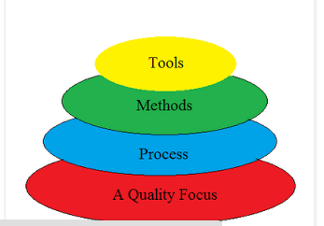
Software Engineering as a Layered Technology
Quality Focus: The bedrock that supports software engineering is quality focus where it ensures continuous process improvement culture.
Process:Foundation for software engineering which enables rational and timely development of computer software
Methods: provide technical how to’s for building software. Involve different tasks including requirements analysis, design, program construction, testing and support. Methods also include modeling activities
Tools: provide automated or semi-automated support for the process and methods
Note: The layered technology will be the focus in this lecture and throughout the semester
Source:
Agarwal, U. (2019). Software Engineering, Kataria and Sons.
https://www.geeksforgeeks.org/layered-technology-in-software-engineering/

Slide 13
Types of Software

Slide 14
Generic and Customized Products
Generic Products
Customized Products
Stand-alone systems that are marketed and sold to any customer who wishes to buy them.
Examples – PC software such as graphics programs, project management tools; CAD software; software for specific markets such as appointments systems for dentists.
The specification of what the software should do is owned by the software developer and decisions on software change are made by the developer.
Software that is commissioned by a specific customer to meet their own needs.
Examples – embedded control systems, air traffic control software, traffic monitoring systems.
The specification of what the software should do is owned by the customer for the software and they make decisions on software changes that are required.

Slide 15
Software Engineering Diversity:
Types of Software
System Software
Real Time Software
Systems for modeling and simulation
Embedded Software
Types of
Software
Interactive Transaction Based Software
Business Software
Stand alone application
Artificial Intelligence Software
Sources: Agarwal, U. (2019). Software Engineering, Kataria and Sons.
Sommerville, I. (2016). Software Engineering 10th edition, Pearson.

Slide 16
Different Types of Software…
System software
  To manage resources and provide clean interfaces to OS services
Real-time software
  monitors, analyzes, and controls real-world events as they occur in real-time; design efforts for this type of software is to guarantee the tasks complete within deadlines
  Response time typically ranges from 1 millisecond to 1 second
Business software
      Management information system (MIS) that accesses one or more databases containing business information (e.g. payroll, inventory)
Embedded software
  Runs on specific devices such as microwave ovens, washing machines, automobiles
  software resides in read only memory and used to control products and systems for the consumer and industrial market

Slide 17
Different Types of Software
System for modeling and simulation
    These are systems developed by scientist and engineers to model physical processes or situations, which often computationally intensive and require high-performance parallel systems for execution
Stand alone application
    Word processing, spreadsheets, computer graphics, multimedia, entertainment, personal and business financial applications, etc.
Interactive transaction-based software
      Applications that execute on a remote computer/server and accessed by users from their own devices that include web applications such as e-commerce that nowadays can be accessed as mobile applications
Artificial intelligence software
  Uses non-numerical algorithms to solve complex problems
  Applications: robotics, expert systems, pattern recognition, adaptive control, game playing

Slide 18
Software failure and inherent difficulties in software engineering

Slide 19
Software Complexity…
Ariane 5 rocket:
  Its maiden flight on June 4, 1996 ended in the launcher being exploded because of a chain of software failures
London Ambulance:
  Because of a succession of software engineering failures the system was introduced that failed twice in the autumn of 1992
  Although the monetary costed at “only” about £9m, was small by comparison with other examples, it is believed that PEOPLE DIED due to the ambulance do not come as promptly as they would
London Stock Exchange (LSE):
  The estimated loss to customers was around £450m and the damage to the reputation of the LSE was incalculable

Slide 20
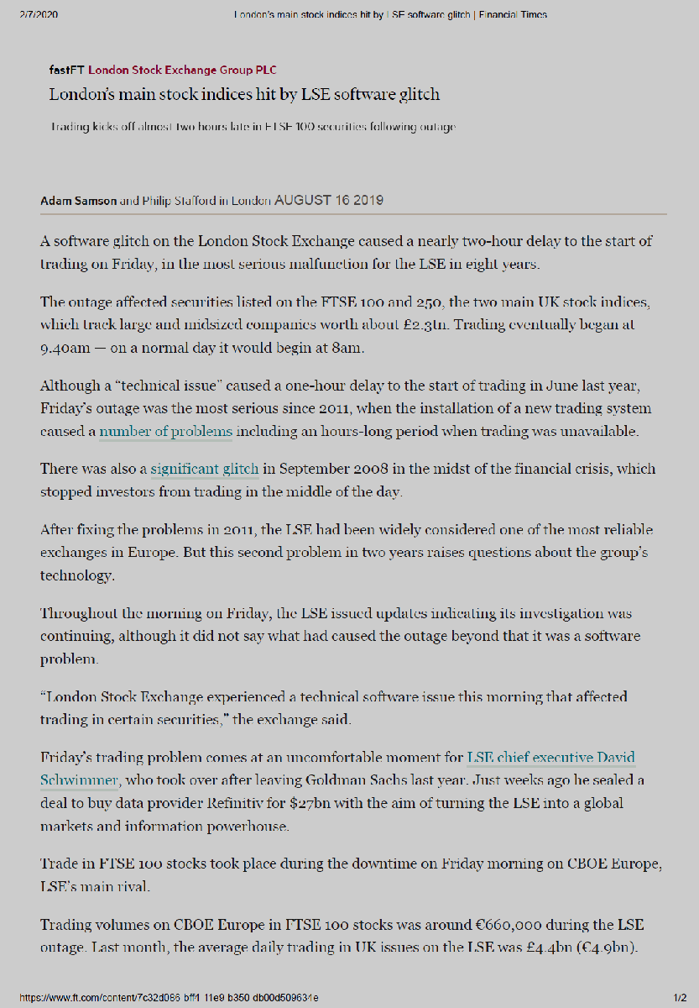

LSE Example
Source: Financial Times
https://www.ft.com/content/7c32d086-bff4-11e9-b350-db00d509634e

Slide 21
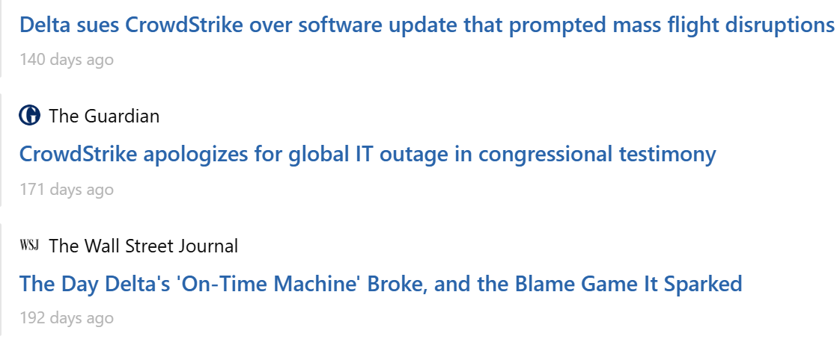
Crowdstrike

Slide 22
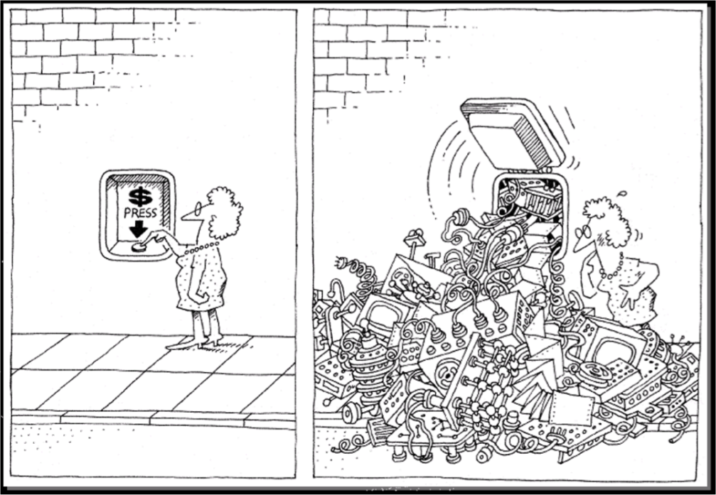
Inherent Difficulties
Software inherent difficulties include:
  Software complexity
  Software changeability
pautasso.info

Slide 23
Software Complexity…
Why is it complex?
No one really understands a large software product as a whole
faults in specifications are made simply because of a lack of understanding of all aspects of the product
no matter how trivial, the various pieces of the product will interact
difficulty due to invisible nature of relationships and imperfect model of reality
No silver bullet
There are many different types of software system and there is no universal set of software techniques that is applicable to all of these
The software engineering methods and tools used depend on the type of application being developed, the requirements of the customer and the background of the development team
    ©2009 J. L. Díaz-Herrera

Slide 24
Software Complexity…
The complexity comes from:
Application domain
  The problems are often very complex
  The developers are not domain experts
Communication among stakeholders (clients, developers)
  The stakeholders use different vocabulary:
    domain experts <=> developers <=> developers
  Human languages are inherently ambiguous
  The stakeholders have different background knowledge
Management of large software development projects
  Need to divide the project into pieces and reassemble the pieces
  Need to coordinate many people

Slide 25
Software Complexity…
Software complexity leads to software quality problems:
  Unreliable e.g. ARIANE 5 rocket
  Unsafe e.g. London Ambulance
  Abandoned e.g. London Stock Exchange
  Inflexible hard to change/maintain - Crowstrike
Software project management problems
Often over schedule and over budget by an order of magnitude
Software engineer productivity problems

Slide 26
Software Changeability
Major changes to software will always and frequently be demanded
  successful software is required to provide more functionality
  software survives hardware
Changing software (“maintenance”)
  is difficult due to dynamic nature of relationships between its interacting parts
    ©2009 J. L. Díaz-Herrera

Slide 27
Software engineering profession and ethics

Slide 28
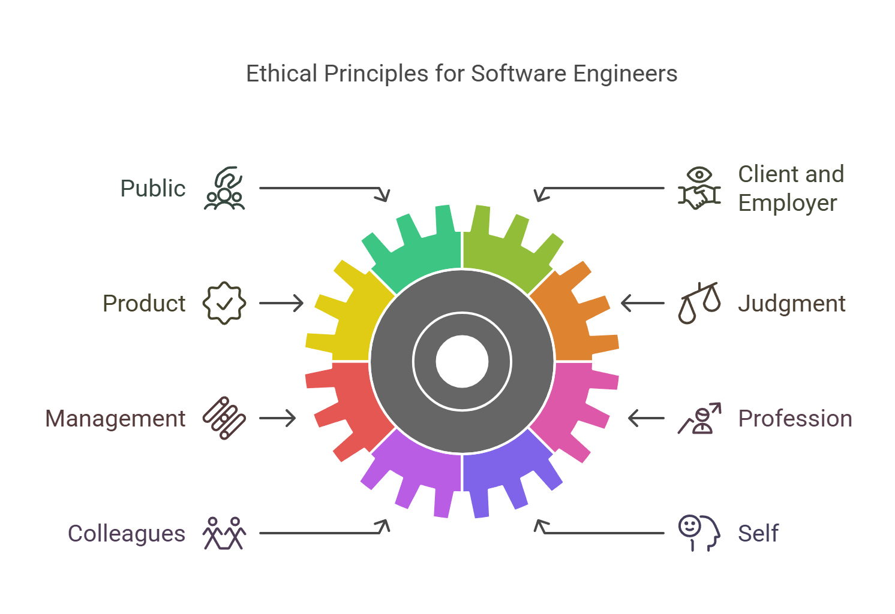
Software Engineering Code of Ethics and Professional (Version 5.2)

Slide 29
Software Engineering Code of Ethics and Professional Practice (Version 5.2)
Software engineers shall adhere to the following Eight Principles:
1. PUBLIC – Software engineers shall act consistently with the public interest.
2. CLIENT AND EMPLOYER – Software engineers shall act in a manner that is in the best interests of their client and employer consistent with the public interest.
3. PRODUCT – Software engineers shall ensure that their products and related modifications meet the highest professional standards possible.
4. JUDGMENT – Software engineers shall maintain integrity and independence in their professional judgment.
5. MANAGEMENT – Software engineering managers and leaders shall subscribe to and promote an ethical approach to the management of software development and maintenance.
6. PROFESSION – Software engineers shall advance the integrity and reputation of the profession consistent with the public interest.
7. COLLEAGUES – Software engineers shall be fair to and supportive of their colleagues.
8. SELF – Software engineers shall participate in lifelong learning regarding the practice of their profession and shall promote an ethical approach to the practice of the profession.

Slide 30
Summary
Key learning outcome
Define software engineering and explain its role in technology.
Understand software engineering as a layered technology, focusing on quality, processes, methods, and tools.
Analyze software failure examples and recognize contributing factors like complexity and uncertainty.
Categorize different types of software and understand their purposes and characteristics.
Understand the responsibilities and ethical considerations of the software engineering profession, including adherence to ethical .

